Slide 1
Channels and gateways
Technical - Overview
Integration Team
2018

Slide 2
AGENDA
Overview
GPP Positioning
Integration Architecture
Interface Layer
Protocols and Transmission
Terminology

Slide 3
“
Global PAYplus (GPP) can integrate with a financial institution’s systems via various interfaces. Each interface is dedicated to a specific functionality”
System Integration – Technical Guide

Slide 4
Gpp positioning
GPP communicates with various upstream, downstream and human channels.
It supports various messaging format and communication protocol.
Supports integration with various technical and business systems.
Integration is achieved by means of Application, environment configuration and development.
Supports Synchronous and Asynchronous communication.

Slide 5






Gpp positioning
SOAP
GPP
Processing Engine
UI
MQ
ADMIN/OPERATION
SOA/WS
DB
FILE/FTP/SFTP

Slide 6
Integration architecture

Slide 7

Communication channels
UI – Operational and Administrative activities
Payment Processing
Reference data update
Reporting
SOA-WS – Initiate processing externally for payment/data
Invokes services from external system
Data upload, SOD/EOD task etc.
MQ – External inbound/outbound asynchronous message processing
File/FTP/SFTP – External inbound/outbound file processing
SOAP – External synchronous data processing

Slide 8


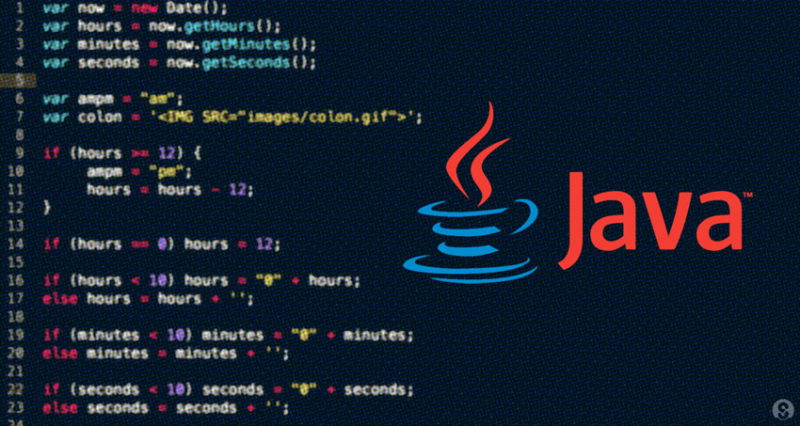
Interface layer
Rule Engine
(interface selection)
GPP SP
Payment Flow
Engine
(interfaces exit points)
payment data
INTERFACE LAYER
Interface Adapter
response data
Message Handler
Configuration
Transmission Layer

Slide 9
Interface configuration attributes
Handler – Java code for parsing/processing message
Direction – Incoming or outgoing
Behavior – Processing behavior in event of interface down
Endpoint – Source or destination for message
Protocol – Transmission protocol to be used i.e. MQ/SOAP/FILE/DB etc
Scaling – Scaling factor for parallel processing

Slide 10
Message Handlers
Rule Engine
(interface selection)
GPP SP
Payment Flow
Engine
(interfaces exit points)
payment data
INTERFACE LAYER
Interface Adapter
response data
Message Handler
Configuration
Transmission Layer
Implemented in Java and configured in respective interface record.
Generates out going message from payment.
De-serializes incoming message and update payment
Capable of generating messages in various formats

Slide 11
Transmission layer
Rule Engine
(interface selection)
GPP SP
Payment Flow
Engine
(interfaces exit points)
payment data
INTERFACE LAYER
Interface Adapter
response data
Message Handler
Configuration
Transmission Layer
Sends and Receive message.
Capable of handling various protocols.
Performs synchronous and asynchronous communication.

Slide 12
Thank you
Rajesh Badiye
Integration Team
Rajesh.badiye@finastra.com

